Slide 1
Introduction to Parallel Processing/Pipelining Basics of pipelining, pipeline hazards, techniques for handling hazards Lecture 35-39 compiled by Dr Veeramanickam M.R.M

Slide 2
Pipelining
Instruction cycle
Parallel processing
Pipelining
Arithmetic pipelining
Pipeline hazards, techniques for handling hazards

Slide 3
Parallel Processing
Parallel processing is a term used to denote a large class of techniques that are used to provide simultaneous data-processing tasks for the purpose of increasing the computational speed of a computer system.
For example, while an instruction is being executed in the ALU , the next instruction can be read from memory. The system may have two or more ALUs and be able to execute two or more instructions at the same time.
Furthermore, the system may have two or more processors operating currently.
To improve the performance of a CPU we have two options: 1) Improve the hardware by introducing faster circuits. 2) Arrange the hardware such that more than one operation can be performed at the same time. Since there is a limit on the speed of hardware and the cost of faster circuits is quite high.
Without pipelining = 9/3 minutes = 3m
I F S | | | | | |
| | | I F S | | |
| | | | | | I F S (9 minutes)

Slide 4
Design of a basic Pipeline
The purpose of parallel processing is to speed up the computer process capability and increase its throughput.*throughput- the amount of processing that can be accomplished during a given time of interval.
Parallel processing is established by distributing the data among the multiple functional units.
For example, arithmetic, logic, and shift operations can be separated into three units and the operands diverted to each unit under the supervision of a control unit.
.
With pipelining = 5/3 minutes = 1.67m
I F S | |
| I F S |
| | I F S (5 minutes)
Thus, pipelined operation increases the efficiency of a system.
.
In a pipelined processor, a pipeline has two ends, the input end and the output end. Between these ends, there are multiple stages/segments such that the output of one stage is connected to the input of the next stage and each stage performs a specific operation.
Interface registers are used to hold the intermediate output between two stages. These interface registers are also called latch or buffer.
All the stages in the pipeline along with the interface registers are controlled by a common clock.

Slide 5
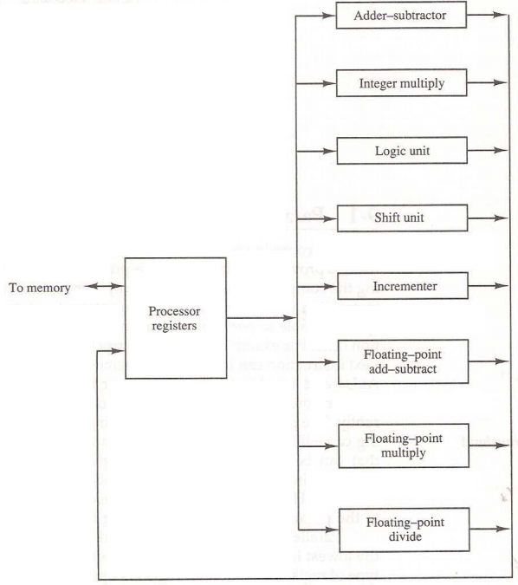
Processor with Multiple Functional Units
Figure 1 shows one possible way of separating the execution unit into eight functional units operating in parallel.
There are a variety of ways that parallel processing can be classified.
It can be considered from the
internal organization of the processors.
interconnection structure between processors.
flow of information through the system.
One Classification introduced by M.J.Flynn considers the organization of a computer system by the number of instructions and data items that are manipulated simultaneously.
Flynn’s classifications divides computers into four major groups:
Single instruction stream, single data stream(SISD)
Single instruction stream, multiple data stream(SIMD)
Multiple instruction stream, single data stream(MISD)
Multiple instruction stream, multiple data stream (MIMD)
Figure 1 Processor with multiple functional Units

Slide 6
Pipelining
Pipelining is a technique of decomposing a sequential process into sub operations, with each subprocess being executed in a special dedicated segments. Pipelining is the process of storing and prioritizing computer instructions that the processor executes. The pipeline is a "logical pipeline" that lets the processor perform an instruction in multiple steps. The processing happens in a continuous, orderly, somewhat overlapped manner.
A Pipeline can be visualized as a collection of processing segments through which binary information flows. The result obtained from the computation in each segment is transferred to the next segment in the pipeline.The final result is obtained after the data have pass through all the segments.
It is the characteristic of the pipelines that several computations can be in progress in distinct segments at the same time. The overlapping of computation is made possible by associating the a register with each segment in pipeline. The registers provide isolation between each segment so that each can operate on distinct data simultaneously.
In computing, pipelining is also known as pipeline processing. It is sometimes compared to a manufacturing assembly line in which different parts of a product are assembled simultaneously, even though some parts may have to be assembled before others. Even if there is some sequential dependency, many operations can proceed concurrently, which facilitates overall time savings.
https://www.techtarget.com/whatis/definition/pipelining

Slide 7

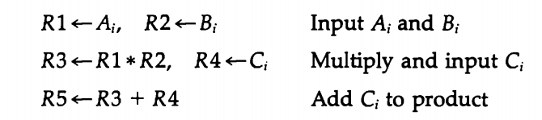
Pipelining
Imagine that each segment consists of an input register followed by a combinational circuit.
The register holds the data and the combinational circuit performs the sub operation in the particular segment.
The output of the combinational circuit in a given segment is applied to the input register of the next segment.
A clock is applied to all registers after enough time has elapsed to perform all segment activity. In this information flows through the pipeline one step at a time.
Example
Suppose that we want to perform the combined multiply and add operations with a stream of numbers.
Each sub operation is to be implemented in a segment within a pipeline. Each segment has one or two registers and a combinational circuit as shown in below Fig. 2. R1 through R5 are registers that receive new data with every clock pulse. The multiplier and adder are combinational circuits. The sub operations performed in each segment of the pipeline are as follows:

Slide 8
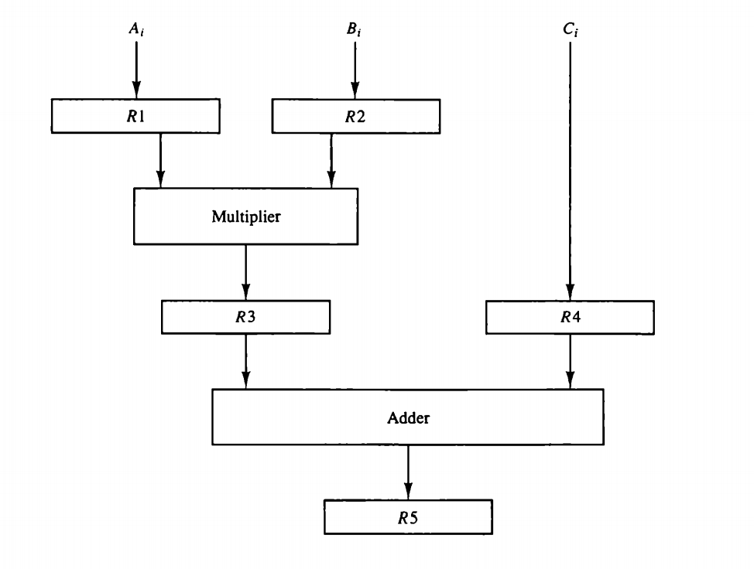
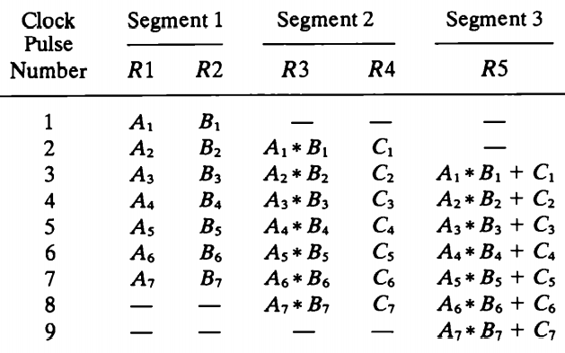
Pipelining
Content of Registers in Pipeline Example
Figure 2 Pipeline processing

Slide 9
Pipelining
The 5 registers are loaded with new data every clock plus.
The effect of each clock is shown in table 1. The first clock pulse transfers A1 and B1 into R2.
The second clock pulse transfers the product of R1 and R2 into R3 and C into R4.
The same clock pulse transfers Az and B2 into R1 and R2.
The third clock pulse operates on all three segments simultaneously.
It places dy and Bz into R1 and R2, transfers the product of R1 and R2 into R3, transfers Cz into R4, and places the sum of R3 and R4 into R5.
It takes three clock pulses to fill up the pipe and retrieve the first output from R5.
From there on, each clock produces a new output and moves the data one step down the pipeline. This happens as long as new input data flow into the system.
When no more input data are available, the clock must continue until the last output emerges out of the pipeline.

Slide 10
General Considerations
Any operation that can be decomposed into a sequence of sub operations of about the same complexity can be implemented by a pipeline processor.
The technique is efficient for those applications that need to repeat the same task many times with different sets of data.
The general structure of a four-segment pipeline is illustrated in Fig. 3.
The operands pass through all four segments in a fixed sequence.
Each segment consists of a combinational circuit S; that performs a sub operation over the data stream flowing through the pipe.
The segments are separated by registers R; that hold the intermediate results between the stages. Information flows between adjacent stages under the control of a common clock applied to all the registers simultaneously.
We define a task as the total operation performed going through all the segments in the pipeline.
The behavior of a pipeline can be illustrated with a space-time diagram.
This is a diagram that shows the segment utilization as a function of time. The space-time diagram of a four-segment pipeline is demonstrated in Fig. 4.
The horizontal axis displays the time in clock cycles and the vertical axis gives the segment number.

Slide 11
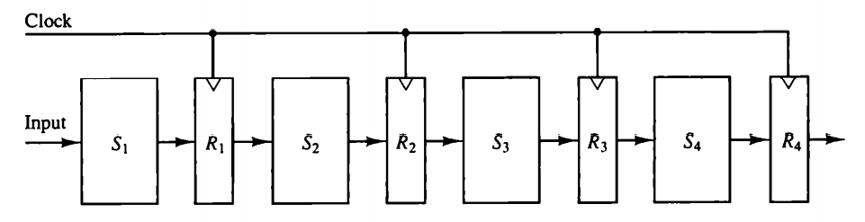
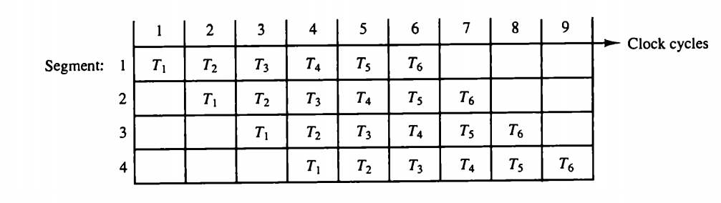
Figure 3 Four segment pipeline
Figure 4 Space time diagram for pipeline

Slide 12


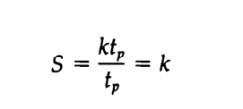
The diagram shows six tasks T, through To executed in four segments. Initially, task Ti is handled by segment 1. After the first clock, segment 2 is busy with Ti, while segment 1 is busy with task Tz. Continuing in this manner, the first task Ti is completed after the fourth clock cycle. From then on, the pipe completes a task every clock cycle.
No matter how many segments there are in the system, once the pipeline is full, it takes only one clock period to obtain an output. Now consider the case where a k-segment pipeline with a clock cycle time to is used to execute n tasks.
The first task Ti requires a time equal to kt, to complete its operation since there are k segments in the pipe.
The remaining n - 1 tasks emerge from the pipe at the rate of one task per clock cycle and they will be completed after a time equal to (n − 1)tp.
Therefore, to complete n tasks using a k-segment pipeline requires k + (n − 1) clock cycles. For example, the diagram of Fig. 4 shows four segments and six tasks.
The time required to complete all the operations is 4 + (6 – 1) = 9 clock cycles, as indicated in the diagram.
Next consider a non pipeline unit that performs the same operation and takes a time equal to t, to complete each task. The total time required for n tasks is nt .
The speedup of a pipeline processing over an equivalent non pipeline processing is defined by the ratio
As the number of tasks increases, n becomes much larger than k – 1, and k + n - 1 approaches the value of n. Under this condition, the speedup becomes
If we assume that the time it takes to process a task is the same in the pipeline and non pipeline circuits, we will have tn = kty. Including this assumption, the speedup reduces to

Slide 13
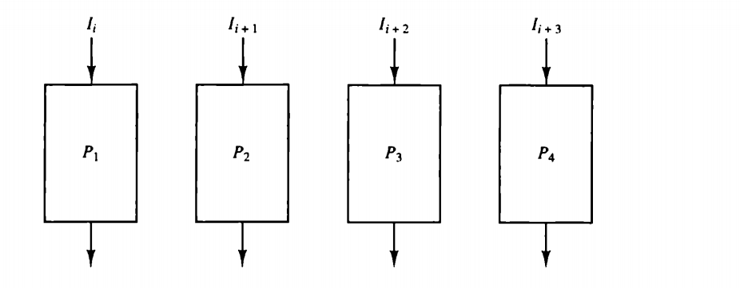
This shows that the theoretical maximum speedup that a pipeline can provide is k, where k is the number of segments in the pipeline.
To clarify the meaning of the speedup ratio, consider the following numerical example.
Let the time it takes to process a sub operation in each segment be equal to tp, = 20 ns.
Assume that the pipeline has k = 4 segments and executes n = 100 tasks in sequence.
The pipeline system will take (k + n - 1)tp = (4 + 99) × 20 = 2060 ns to complete.
Assuming that tn = ktp = 4 x 20 = 80ns, a non pipeline system requires nktp = 100 X 80 = 8000 ns to complete the 100 tasks.
The speedup ratio is equal to 8000/2060 = 3.88. As the number of tasks increases, the speedup will approach 4, which is equal to the number of segments in the pipeline.
If we assume that tn = 60 ns, the speedup becomes 60/20 = 3.
Figure 5 Multiple Functional units in parallel

Slide 14
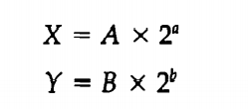
Arithmetic Pipelining
Pipeline arithmetic units are usually found in very high speed computers.
They are used to implement floating-point operations, multiplication of fixed-point numbers, and similar computations encountered in scientific problems.
The inputs to the floating-point adder pipeline are two normalized floating-point binary numbers.
A and B are two fractions that represent the mantissas and a and b are the exponents.
The floating-point addition and subtraction can be performed in four segments, as shown in Fig. 6.
The registers labeled R are placed between the segments to store intermediate results.
The suboperations that are performed in the four segments are:
1. Compare the exponents.
2. Align the mantissas.
3. Add or subtract the mantissas.
4. Normalize the result.

Slide 15
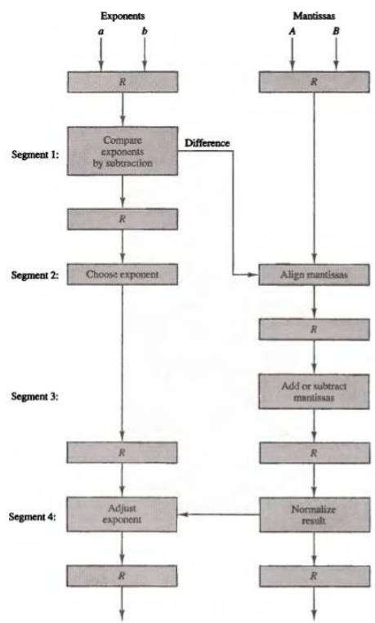
The following numerical example may clarify the sub operations performed in each segment.
For simplicity, we use decimal numbers, although Fig.6 refers to binary numbers.
Consider the two normalized floating-point numbers:
X = 0.9504 x 10³ ………….1
Y = 0.8200 x 10²…………...2
The two exponents are subtracted in the first segment to obtain 3 - 2 = 1. The larger exponent 3 is chosen as the exponent of the result. The next segment shifts the mantissa of Y to the right to obtain
X = 0.9504 x 10³ ………….3
Y = 0.0820 x 10³…………..4
This aligns the two mantissas under the same exponent. The addition of the two mantissas in segment 3 produces the sum
Z = 1.0324 x 10³………….5
Z = 1.0324 x 10⁴………….6
Figure 6 Pipeline for floating -point addition and subtraction

Slide 16
The Concept of Pipeline Hazards
Pipeline Hazards are often seen as missteps in the optimisation of processes within the pipelining concept.
Understanding pipeline hazards require a solid comprehension of how pipelining works in the first place. In a nutshell, pipelining is a technique where multiple instructions are overlapped during execution.
However, certain conditions can interfere with the smooth flow of this process - hence leading to pipeline hazards.
There are three stages in the instruction cycle where a pipeline hazard can occur: during instruction fetch, during instruction decode, and during instruction execute.
The hazards that occur with the instruction fetch are usually related to issues with the memory system such as latency.
.
https://witscad.com/course/computer-architecture/chapter/pipeline-hazards

Slide 17
The Concept of Pipeline Hazards
A common example of this is if two instructions that are close to each other in the instruction stream need to access the same memory location, a conflict termed as a conflict miss, may occur.
During the decoding stage, an instruction might need to wait for the completion of another instruction which currently occupies the decoder.
This could happen if, for example, a comparator check fails to have the expected output.
Lastly, hazards during the execution stage can occur if there is contentious access to a functional unit like Register File, ALU etc.
https://www.lkouniv.ac.in/site/writereaddata/siteContent/202004221613338445rohit_engg_pipelining_and_hazzard.pdf

Slide 18
Different Types of Pipeline Hazards
Structural Hazards: These occur when the same hardware resource is desired by multiple instructions at the same time.
Data Hazards: They come into play when the execution of one instruction depends on the completion of another.
Control Hazards: These result from the pipelining of branches and other instructions that change the PC.
Control Hazards in Pipelining
Control hazards are one of the most complex types of pipeline hazards because of their connection to the control flow of the program. Control hazards come from the pipelining of branches and other instructions that cause changes to the PC
https://www.cs.umd.edu/~meesh/411/CAonline/chapter/pipeline-hazards/index.html

Slide 19
Data Hazards in Pipelining
Data hazards occur when there is a conflict in the access or use of operand data.
These can be categorized into three types: read-after-write (RAW), write-after-read (WAR), and write-after-write (WAW).
A RAW hazard, also known as a true dependency, occurs when an instruction depends on the result of a previous instruction.
A WAR hazard occurs when an instruction depends on the reading of a value before that value is overwritten by a previous instruction.
A WAW hazard occurs when a value is written by an instruction before the previous instruction writes that value.
https://www.geeksforgeeks.org/computer-organization-and-architecture-pipelining-set-2-dependencies-and-data-hazard/

Slide 20
Analysing Control Hazards in Pipelining Example
Pipelining is an effective way to increase instruction throughput and improve the performance of your computer.
However, this methodology isn't without its complications.
Particular problem areas occur when control flow instructions like branches and jumps are pipelined.
They can lead to delays in instruction execution due to Pipeline Hazards, particularly Control Hazards.
https://www.studysmarter.co.uk/explanations/computer-science/computer-organisation-and-architecture/pipeline-hazards/

Slide 21
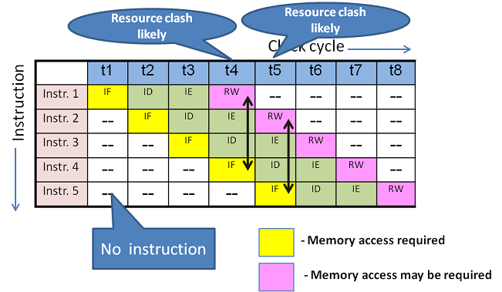
Structural dependency scenario

Slide 22
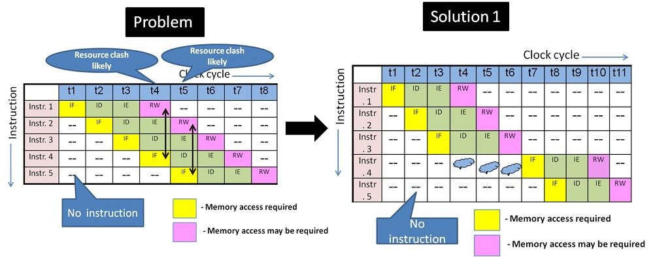
Structural Hazard solution using "stall" in a 4 stage pipeline design

Slide 23
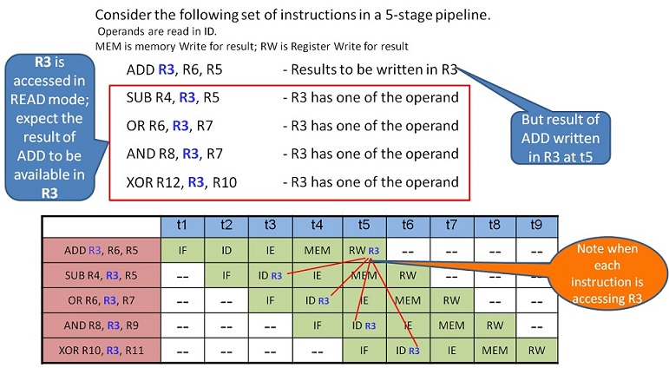
Data Hazard scenario

Slide 24
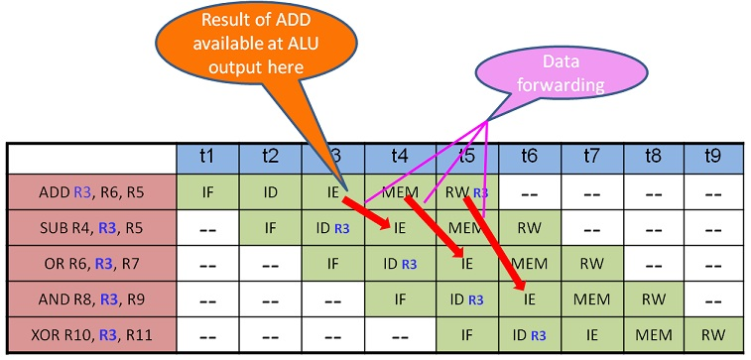
Data forwarding solution for Data Hazard

Slide 25
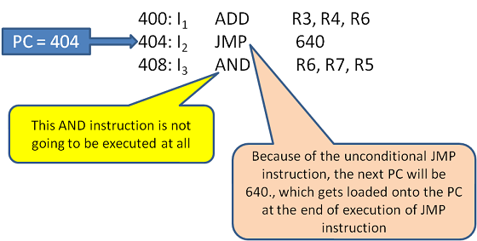
Control Hazard scenario

